Slide 1
Smart visual computing research review
Chueh Ting, PhD
2023 0420

Slide 2
Contents
Smart visual computing platform
Optical metamaterials functionalities
Optical metamaterials applications
Chueh Ting 2023 0420

Slide 3


Smart visual computing platform
Key technologies
Adaptive
information
tranceiver
mmWave/THz/FSO beam-forming
OAM-MIMO
mmWave/THz/FSO connectivity
NG adaptive signal processing (NG-GPT/BERT/CNN)
Adaptive optics
Optical see through computing
Advanced integrated EO chip
Smart information
processing
Adaptive
information
collector
See through
display
Applications
Vision-based autonomous systems
Visual navigation systems
Observed
information
Chueh Ting 2023 0420

Slide 4
Optical metamaterials functionalities
Wavefront modification
Wavelength selection
Frequency conversion
Emission adjustment
Temporal/spatial dispersion generation
Polarization tunability
Quantum state control
Chueh Ting 2023 0420

Slide 5
Optical metamaterials applications
Beam-forming
AOM-MIMO
Pixel-size optical devices
Miniature adaptive optics
Chueh Ting 2023 0420

Slide 6
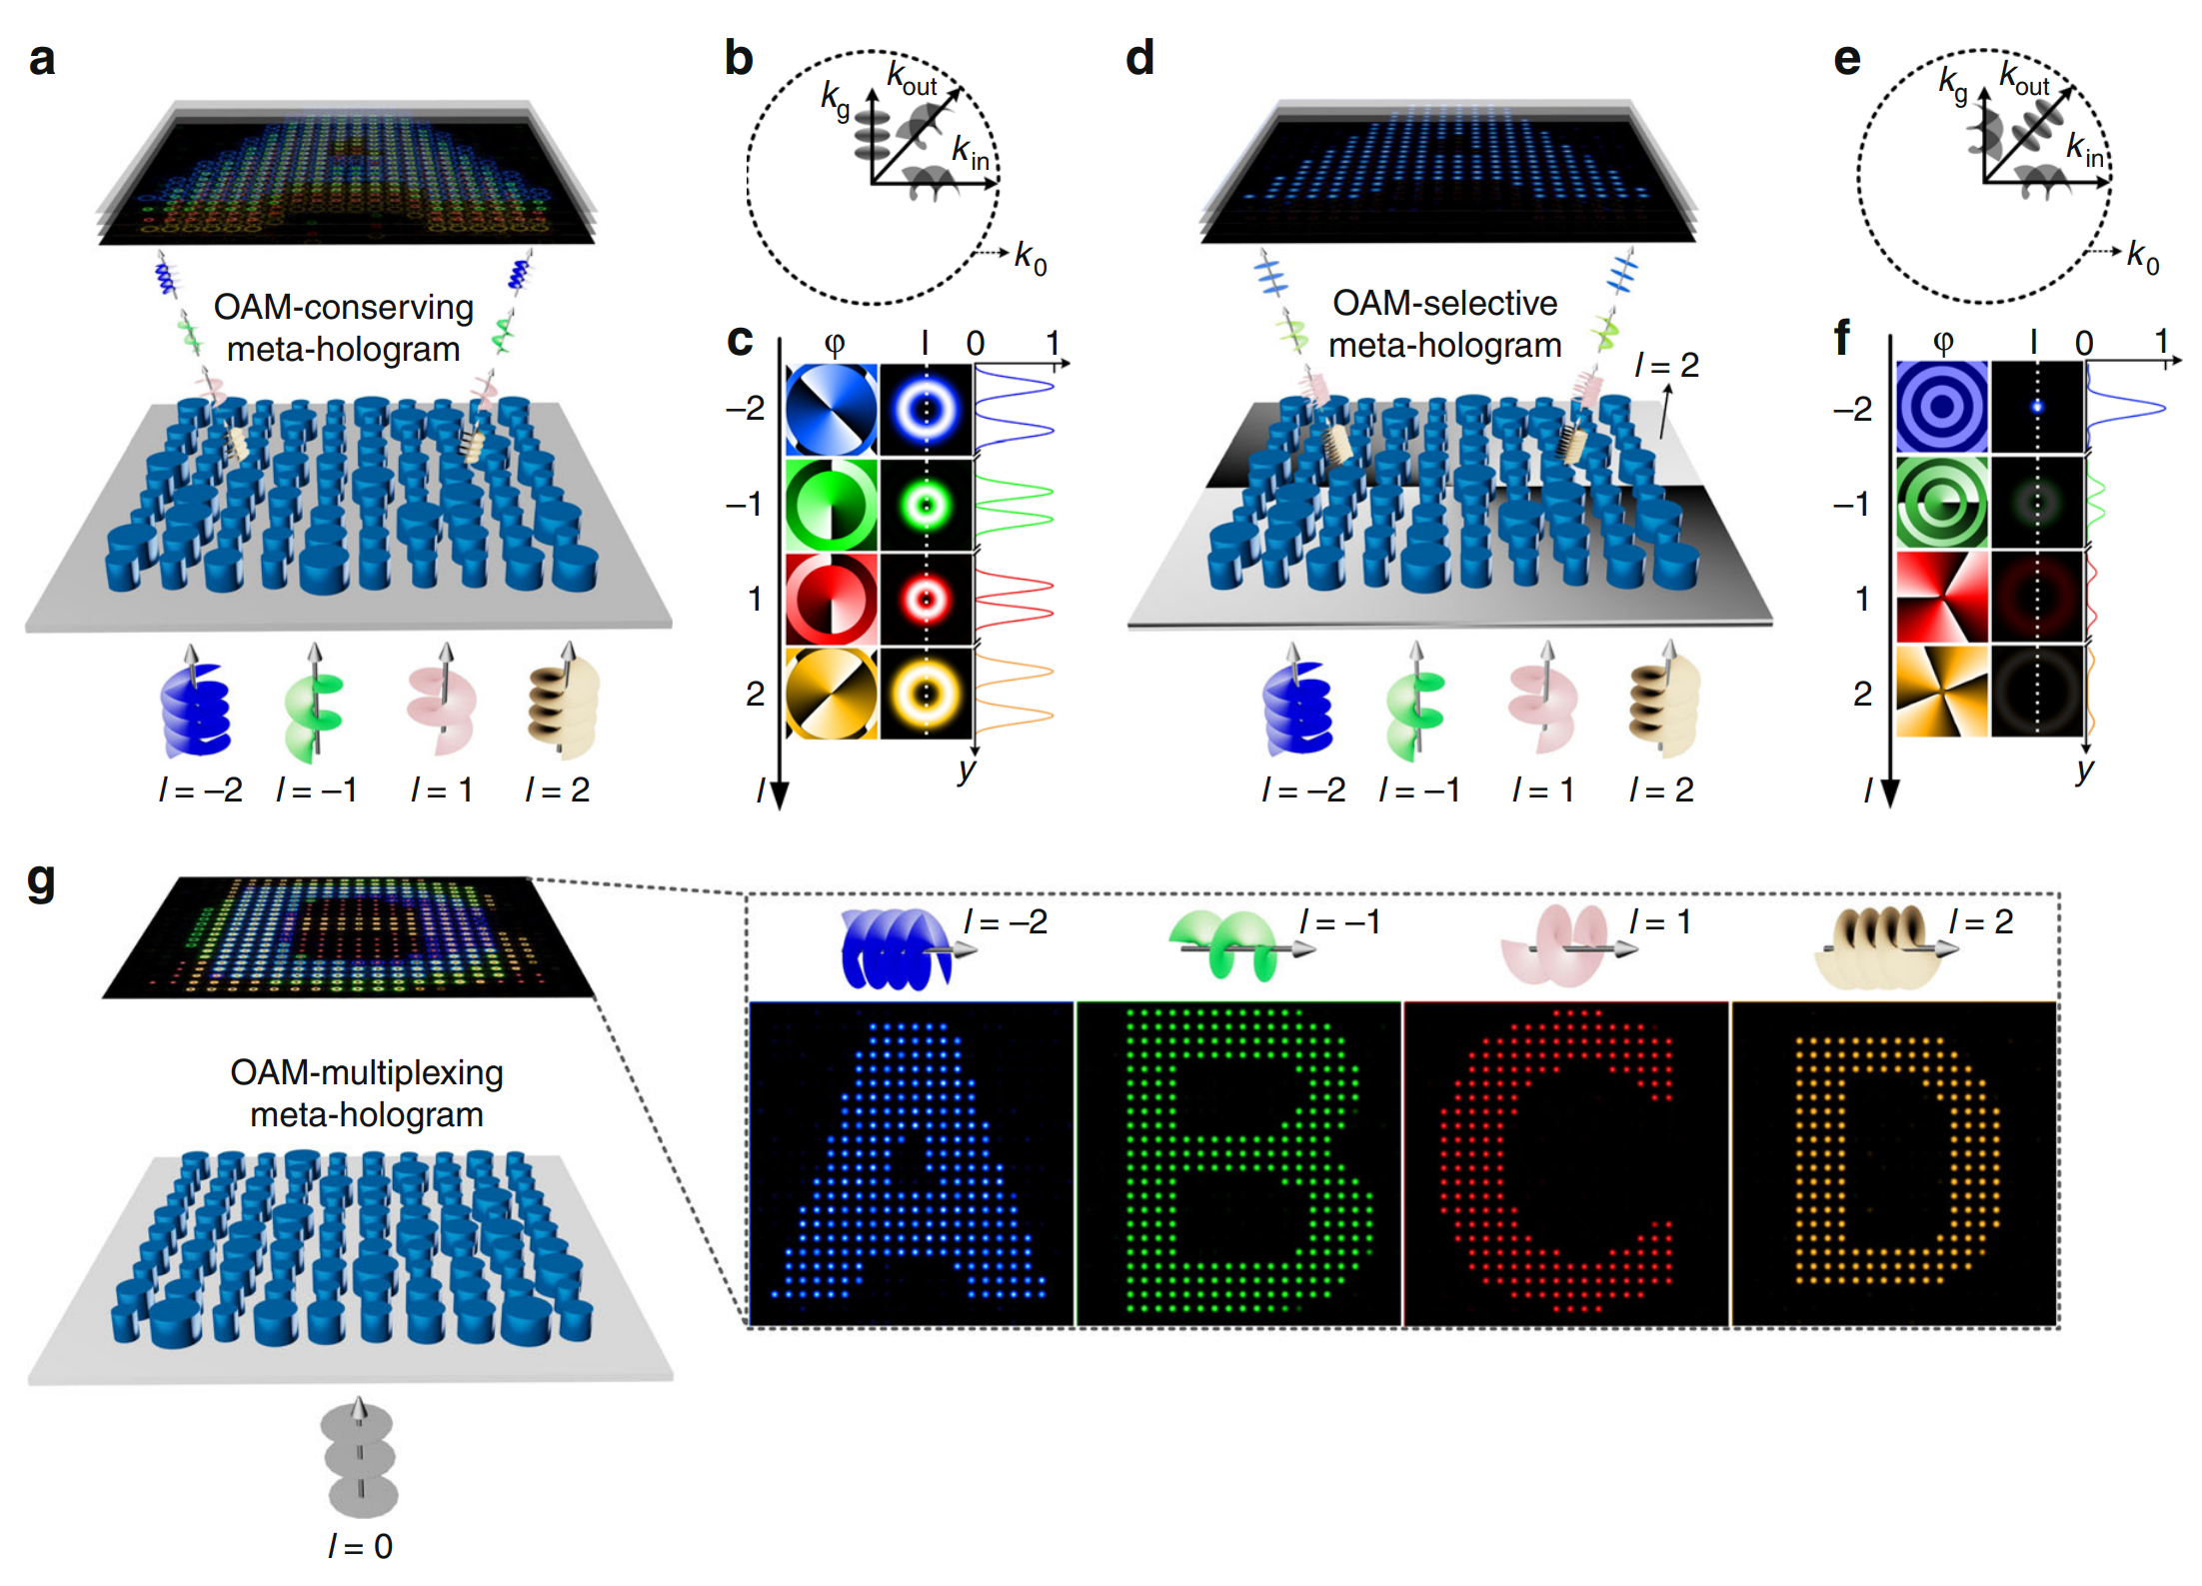
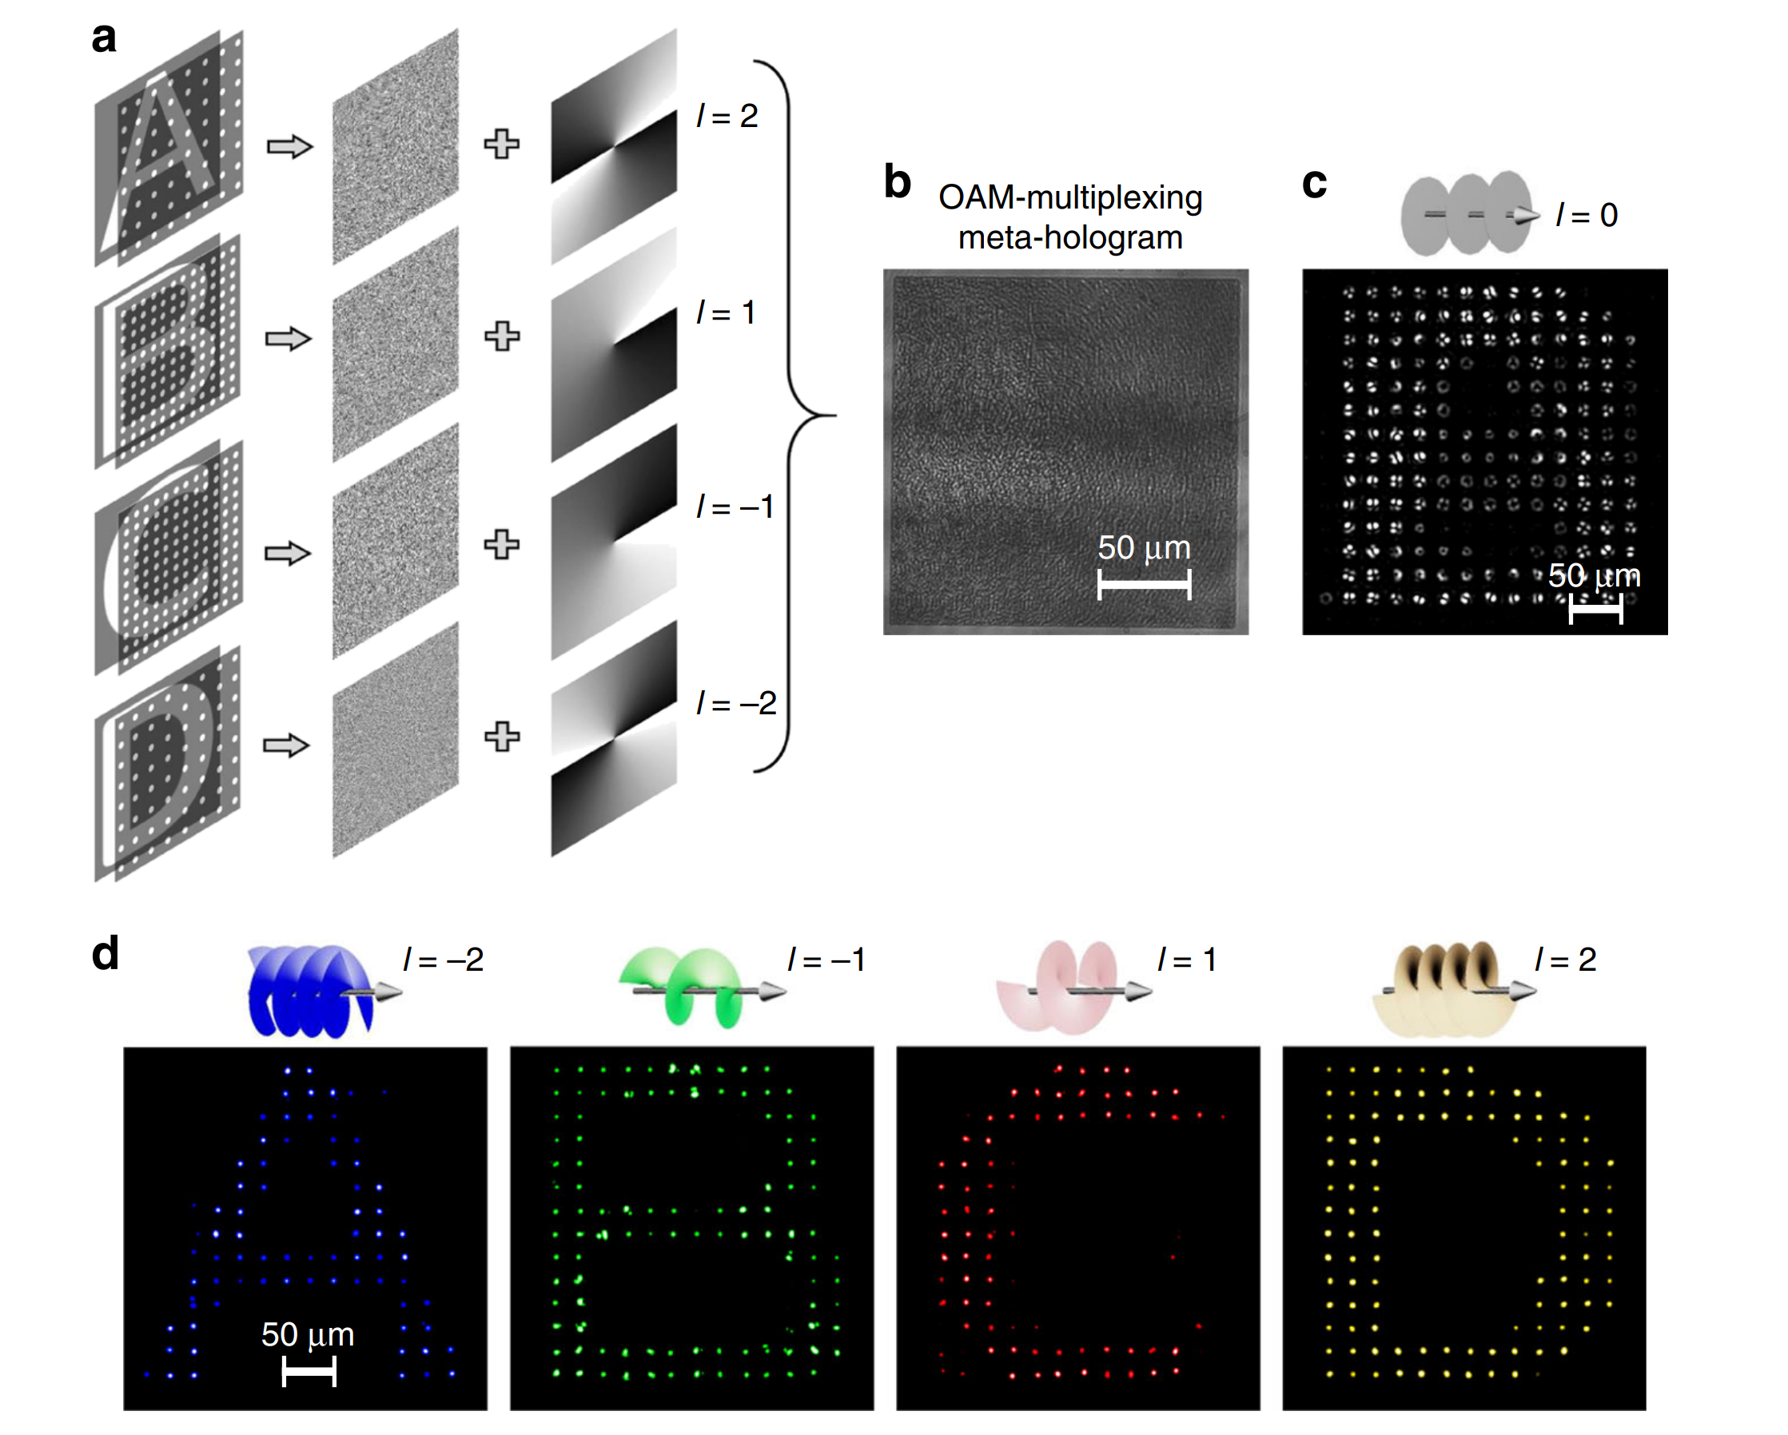
OAM-MIMO
Ren, H. et al. Metasurface orbital angular momentum holography. Nat. Commun. 10, 2986 (2019).
Chueh Ting 2023 0420

Slide 7
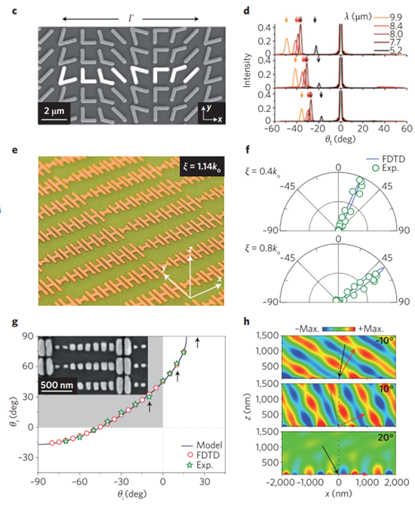
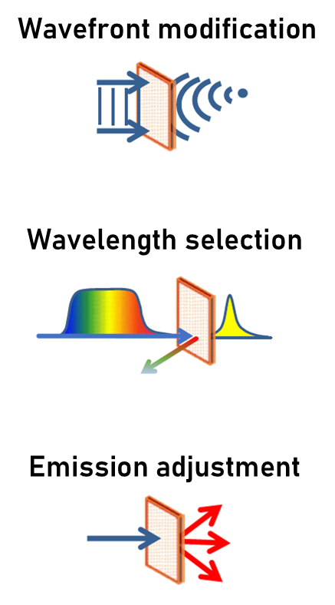
Pixel-size optical devices
Yu, N. & Capasso, F. Flat optics with designer metasurfaces. Nat. Mater. 13, 139–150 (2014).
Chueh Ting 2023 0420

